Slide 1
Distributed Systems
Name Services
Chapter 9:
Introduction
Name services and the DNS
Discovery services

Slide 2
The role of names and name services
Resources are accessed using identifier or reference
  An identifier can be stored in variables and retrieved from tables quickly
  Identifier includes or can be transformed to an address for an object
    E.g. NFS file handle, remote object reference
  A name is human-readable value (usually a string) that can be resolved to an identifier or address
    Internet domain name, file pathname, process number
    E.g ./etc/passwd, http://www.cdk3.net/
For many purposes, names are preferable to identifiers
  because the binding of the named resource to a physical location is deferred and can be changed
  because they are more meaningful to users
Resource names are resolved by name services
  to give identifiers and other useful attributes
*

Slide 3
Requirements for name spaces
Allow simple but meaningful names to be used
Potentially infinite number of names
Structured
  to allow similar subnames without clashes
  to group related names
Allow re-structuring of name trees
  for some types of change, old programs should continue to work
Management of trust
*
Notes:
Students should read Section 9.2.1

Slide 4
Composed naming domains used to access a resource from a URL
Figure 9.1
URL
http://www.cdk3.net:8888/WebExamples/earth.html
DNS lookup
Resource ID (IP number, port number, pathname)
138.37.88.61
8888
WebExamples/earth.html
ARP lookup
(Ethernet) Network address
2:60:8c:2:b0:5a
file
Socket
Web server
*

Slide 5
Names and resources
Currently, different name systems are used for each type of resource:
  resource name identifies
  file pathname file within a given file system
  process process id process on a given computer
  port port number IP port on a given computer
Uniform Resource Identifiers (URI) offer a general solution for any type of resource. There two main classes:
    URL Uniform Resource Locator
      typed by the protocol field (http, ftp, nfs, etc.)
      part of the name is service-specific
      resources cannot be moved between domains
    URN Uniform Resource Name
      requires a universal resource name lookup service - a DNS-like system for all resources
More on URNs
format: urn:<nameSpace>:<name-within-namespace>
examples:
a) urn:ISBN:021-61918-0
b) urn:dcs.qmul.ac.uk:TR2000-56
resolution:
send a request to nearest ISBN-lookup service - it would return
whatever attributes of a book are required by the requester
b) send a request to the urn lookup service at dcs.qmul.ac.uk
- it would return a url for the relevant document
*
Notes:
Popup: showing examples of URNs

Slide 6
Iterative navigation
Figure 9.2
NS2
2
Name
Client
1
NS1
servers
3
NS3
A client iteratively contacts name servers NS1–NS3 in order to resolve a name
Used in:
DNS: Client presents entire name to servers, starting at a local server, NS1. If NS1 has the requested name, it is resolved, else NS1 suggests contacting NS2 (a server for a domain that includes the requested name).
*

Slide 7
Non-recursive and recursive server-controlled navigation
Figure 9.3
NS2
NS2
2
2
1
4
3
NS1
1
NS1
client
client
4
3
5
NS3
NS3
Non-recursive
Recursive
server-controlled
server-controlled
A name server NS1 communicates with other name servers on behalf of a client
DNS offers recursive navigation as an option, but iterative is the standard technique. Recursive navigation must be used in domains that limit client access to their DNS information for security reasons.
*

Slide 8
DNS - The Internet Domain Name System
A distributed naming database
Name structure reflects administrative structure of the Internet
Rapidly resolves domain names to IP addresses
  exploits caching heavily
  typical query time ~100 milliseconds
Scales to millions of computers
  partitioned database
  caching
Resilient to failure of a server
  replication
Basic DNS algorithm for name resolution (domain name -> IP number)
Look for the name in the local cache
Try a superior DNS server, which responds with:
  – another recommended DNS server
  – the IP address (which may not be entirely up to date)
*

Slide 9
DNS Name Servers
The problem of scale (large number of records) are treated:
  Partitioning the name DB
  Replicating
  Caching
The DNS naming data is divided into Zones. A zone contains:
  Attribute data for name in domain e.g., mcs.edu.pk or cs.mcs.edu.pk
  The names and addresses of at least two name servers that provide authoritative data for the zone (to avoid single point of failure).
  Zone management parameters, such as caching and replication of zone data
System Admin enters data for the zone in a Master File, which is the source of authoritative data.
  A primiary/master server reads data directly from master file
  A secondary server downloads zone data periodically from master

Slide 10
DNS name servers
a.root-servers.net
(root)
uk
ns1.nic.uk
purdue.edu
Note: Name server names are in italics, and the corresponding domains are in parentheses.
Arrows denote name server entries
(uk)
yahoo.com
....
ns.purdue.edu
co.uk
(purdue.edu)
ac.uk
...
ns0.ja.net
(ac.uk)
* .purdue.edu
ic.ac.uk
authoritative path to lookup:
jeans-pc.dcs.qmw.ac.uk
qmw.ac.uk
...
alpha.qmw.ac.uk
dns0.dcs.qmw.ac.uk
dns0-doc.ic.ac.uk
(qmw.ac.uk)
(dcs.qmw.ac.uk)
(ic.ac.uk)
dcs.qmw.ac.uk
*.dcs.qmw.ac.uk
*.ic.ac.uk
*.qmw.ac.uk
*

Slide 11
DNS in typical operation
a.root-servers.net
Without caching
(root)
uk
ns1.nic.uk
purdue.edu
(uk)
yahoo.com
....
ns.purdue.edu
co.uk
(purdue.edu)
ac.uk
...
ns0.ja.net
(ac.uk)
* .purdue.edu
ic.ac.uk
qmw.ac.uk
...
IP: alpha.qmw.ac.uk
2
alpha.qmw.ac.uk
dns0.dcs.qmw.ac.uk
dns0-doc.ic.ac.uk
client.ic.ac.uk
(qmw.ac.uk)
(dcs.qmw.ac.uk)
(ic.ac.uk)
IP:jeans-pc.dcs.qmw.ac.uk
IP:ns0.ja.net
dcs.qmw.ac.uk
*.dcs.qmw.ac.uk
*.ic.ac.uk
1
4
*.qmw.ac.uk
jeans-pc.dcs.qmw.ac.uk ?
3
IP:dns0.dcs.qmw.ac.uk
*
Notes:
Animation: reveals each step in looking up jeans-pc.dcs.qmw.ac.uk from a client in the ic.ac.uk domain

Slide 12
DNS server functions and configuration
Main function is to resolve domain names for computers, i.e. to get their IP addresses
  caches the results of previous searches until they pass their 'time to live'
Other functions:
  get mail host for a domain
  reverse resolution - get domain name from IP address
  Host information - type of hardware and OS
  Well-known services - a list of well-known services offered by a host
  Other attributes can be included (optional)
*

Slide 13
DNS resource records
Record type
Meaning
Main contents
A
A computer address
IP number
NS
An authoritative name server
Domain name for server
CNAME
The canonical name for an alias
Domain name for alias
SOA
Marks the start of data for a zone
Parameters governing the zone
WKS
A well-known service description
List of service names and protocols
PTR
Domain name pointer (reverse
Domain name
lookups)
HINFO
Host information
Machine architecture and operating
system
MX
Mail exchange
List of <
preference, host
> pairs
TXT
Text string
Arbitrary text
*

Slide 14
DNS issues
Name tables change infrequently, but when they do, caching can result in the delivery of stale data.
  Clients are responsible for detecting this and recovering
Its design makes changes to the structure of the name space difficult. For example:
  merging previously separate domain trees under a new root. E.g., .com and .net under .edu also lets say *.uk needs to be *.uk.eu
  moving sub-trees to a different part of the structure (e.g. if Scotland became a separate country, its domains should all be moved to a new country-level domain). E.g., if *.so.uk changes to *.so
*

Slide 15


Slide 16
DNS: Domain Name System
People:
  many identifiers: SSN, name, Passport #
Internet hosts, routers:
  IP address (32 bit) - used for addressing datagrams
  “name”, e.g., www.postech.ac.kr - used by humans
Q: map between IP addresses and name ?
Domain Name System:
distributed database implemented in hierarchy of many name servers
application-layer protocol
host, routers, name servers to communicate to resolve names (address/name translation)
  note: core Internet function implemented as application-layer protocol
  complexity at network’s “edge”
Application Layer

Slide 17
DNS name servers
Why not centralize DNS?
single point of failure
traffic volume
distant centralized database
maintenance
Just doesn’t scale!
no server has all name-to-IP address mappings
local name servers:
  each ISP, company has local (default) name server
  host DNS query first goes to local name server
authoritative name server:
  for a host: stores that host’s IP address, name
  can perform name/address translation for that host’s name
Application Layer

Slide 18
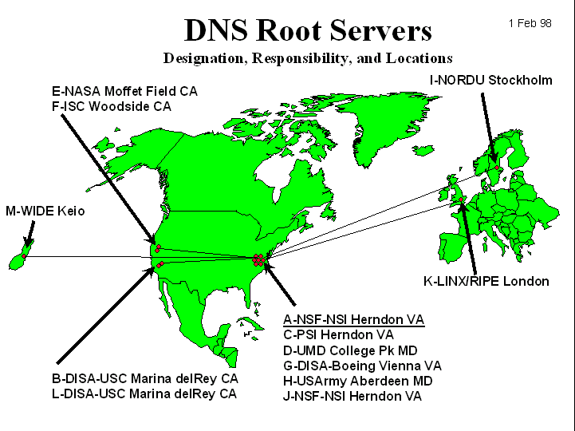
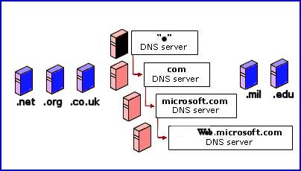
DNS: Root name servers
contacted by local name server that can not resolve name
root name server:
  contacts authoritative name server if name mapping not known
  gets mapping
  returns mapping to local name server
13 root name servers worldwide
Application Layer

Slide 19

Simple DNS example
root name server
host surf.eurecom.fr wants IP address of gaia.cs.umass.edu
1. Contacts its local DNS server, dns.eurecom.fr
2. dns.eurecom.fr contacts root name server, if necessary
3. root name server contacts authoritative name server, dns.umass.edu, if necessary
2
4
5
3
local name server
dns.eurecom.fr
authorititive name server
dns.umass.edu
1
6
requesting host
surf.eurecom.fr
gaia.cs.umass.edu
Application Layer

Slide 20
DNS: iterated queries
root name server
recursive query:
puts burden of name resolution on contacted name server
heavy load?
iterated query:
contacted server replies with name of server to contact
“I don’t know this name, but ask this server”
once (any) name server learns mapping, it caches mapping
2
iterated query
3
4
7
local name server
dns.eurecom.fr
intermediate name server
dns.umass.edu
5
6
1
8
authoritative name server
dns.cs.umass.edu
requesting host
surf.eurecom.fr
gaia.cs.umass.edu
Application Layer

Slide 21
DNS records
DNS: distributed db storing resource records (RR)
RR format: (name, value, type, ttl)
Type=A (Address Record)
  name is hostname
  value is IP address
Type=CNAME (Canonical name record)
  name is an alias name for some “cannonical” (the real) name
  value is cannonical name
Type=NS (Name Server Record)
  name is domain (e.g. foo.com)
  value is IP address of authoritative name server for this domain
Type=MX (mail exchanger record)
  value is hostname of mailserver associated with name
Application Layer

Slide 22

DNS protocol, messages
DNS protocol : query and repy messages, both with the same message format
msg header
identification: 16 bit # for query, reply to query uses same #
flags:
  query or reply
  recursion desired
  recursion available
  reply is authoritative
Application Layer

Slide 23
DNS protocol, messages
Name, type fields
for a query
RRs in reponse
to query
records for
authoritative servers
additional “helpful”
info that may be used
Application Layer

